Slide 1




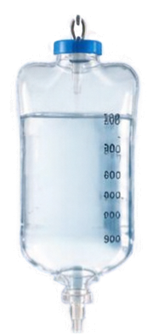
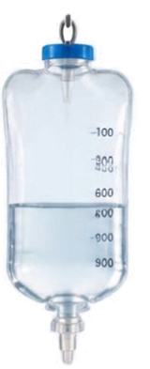
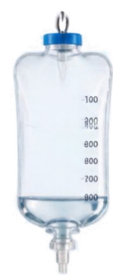











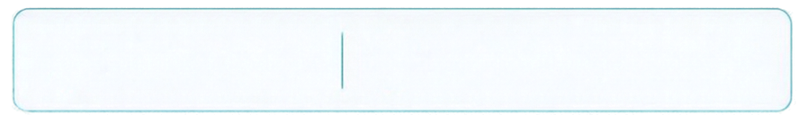


THE PROBLEM
MANUAL MONITORING
DELAYED ATTENTION
INCREASED WORKLOAD
RISK OF SALINE RUNNING OUT
NORMAL
LOW
CRITICAL
Saline Level ↓
Monitoring Difficulty ↑
Can we monitor saline levels automatically?

Slide 2


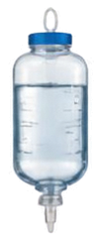





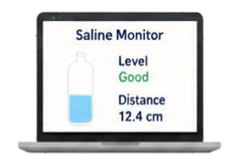
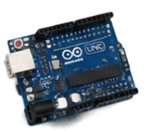

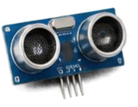
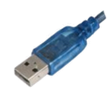





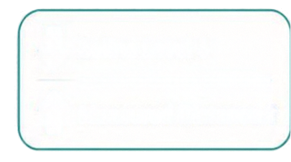


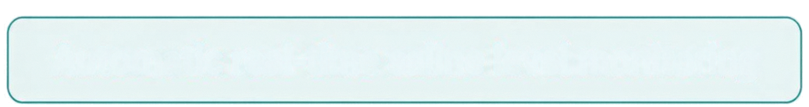
OUR SOLUTION
Ultrasonic
Sensor
Arduino
PySerial
Python
Tkinter UI
Warning /
Status
Saline Level ↓
Measured Distance ↑
Automatic real-time saline level monitoring

Slide 3








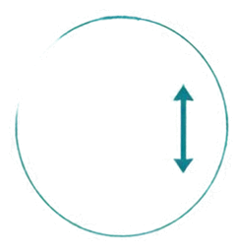


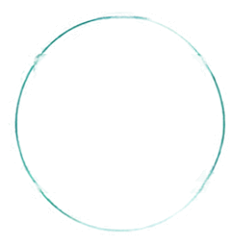

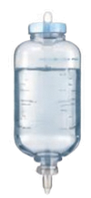
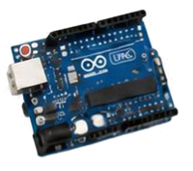
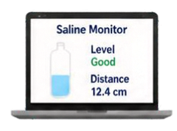

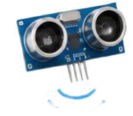
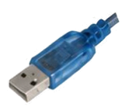













HOW DOES IT WORK?
01
02
03
04
05
06
Detect
Measure
Process
Transfer
Display
Alert
Ultrasonic sensor emits waves toward saline surface
Calculates distance to saline surface
Arduino reads
sensor value
PySerial sends
data to computer
Python Tkinter shows current status
If distance crosses threshold →
LOW SALINE WARNING
Saline Level
Distance
Warning

Slide 4


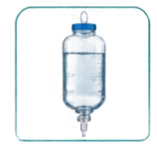
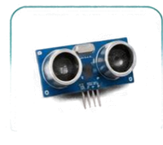
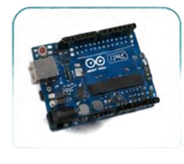
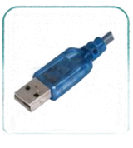



















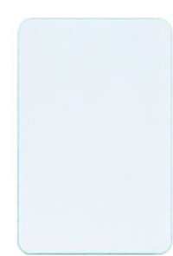
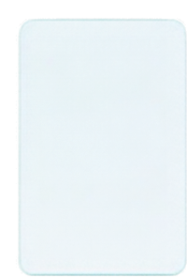
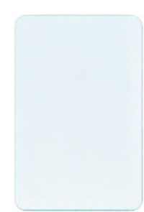
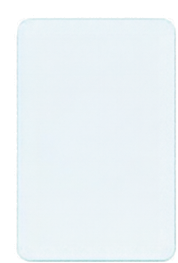
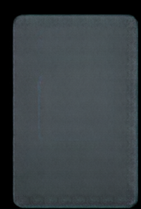
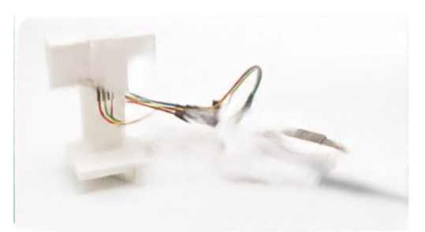
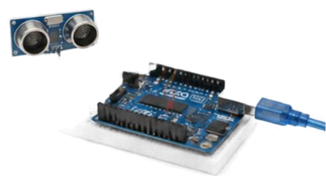
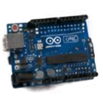
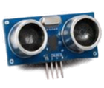



SYSTEM ARCHITECTURE
USB /
SERIAL
SALINE BOTTLE
ULTRASONIC SENSOR
ARDUINO
PYSERIAL
PYTHON
APPLICATION
TKINTER GUI
SALINE STATUS / ALERT
Contains saline solution
Measures distance to liquid surface
Processes sensor data and controls system
Handles serial communication
Processes data
and applies logic
Displays real-time information
Indicates reel status and alerts
TECHNOLOGY STACK
PROTOTYPE SETUP (HARDWARE)
ARDUINO
ULTRASONIC
SENSOR
PYSERIAL
PYTHON
TKINTER
Sensor control
and data handling
Distance
measurement
Serial
communication
Data processing and logic
User interface
and visualization

Slide 5




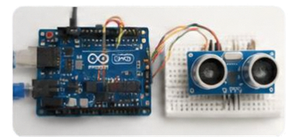










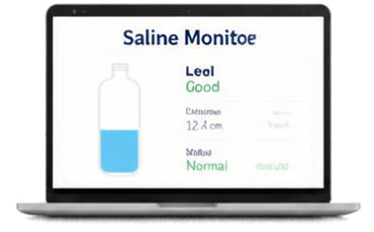





PROTOTYPE → IMPACT → FUTURE
PROTOTYPE
IMPACT
FUTURE SCOPE
Continuous
Monitoring
Current Prototype
Mobile Notifications
Physical
Sensor
Early
Warning
Arduino + Ultrasonic Sensor
Multiple Bottle Monitoring
Digital
Dashboard
Reduced
Manual Checking
Cloud Connectivity
Nurse-Station Alerts
Low-Cost
Solution
Predictive Monitoring
Tkinter Monitoring Dashboard

Slide 6

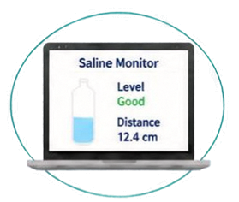
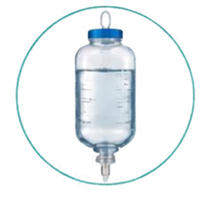
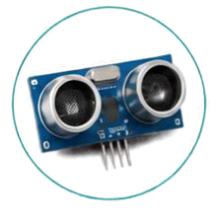
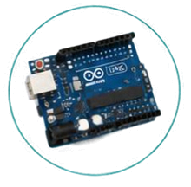





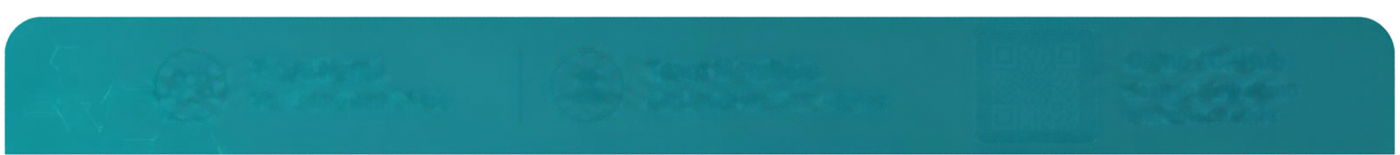


FROM MANUAL MONITORING
TO SMART MONITORING
Saline Bottle
Sensor
Arduino
Python UI
Early Warning
A simple IoT solution for smarter and proactive saline-level monitoring.
MONITOR
DETECT
ALERT
Team Name
Team Members
TECHNOVA
Khushi , Tushar , Manish and Aqsa
THANK YOU

